Slide 1
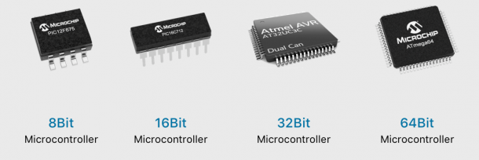
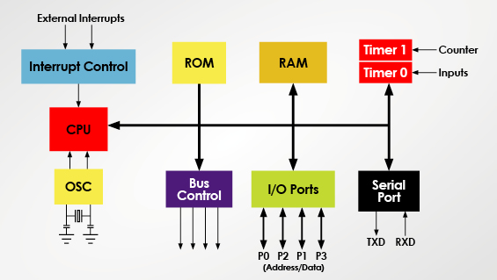
Micro Processing System
Micro-Controller and Micro-Processor Unit
LÊ TRỌNG NHÂN
trongnhanle@hcmut.edu.vn
trongnhanle85@gmail.com

Slide 2

Zalo Group [KSTN]
15 weeks for Lectures
6 weeks for Labs (30%)
MCQs for Mid-term (20%)
MCQs for Final-term (50%)
Final project: +1 maximum
https://zalo.me/g/yhlqbv805

Slide 3
Zalo Group [CLC]
15 weeks for Lectures
6 weeks for Labs (30%)
MCQs for Mid-term (20%)
MCQs for Final-term (50%)
Final project: +2 maximum

Slide 4

Course Information
15 weeks for Lectures
6 weeks for Labs (30%)
MCQs for Mid-term (20%)
MCQs for Final-term (50%)
Final project: +2 maximum
https://zalo.me/g/wwicvv724

Slide 5
15 Weeks for Lectures
Understand microcontroller basics including all common interfaces:
  General Input/Output GPIO (LEDs, Buttons)
  Interrupts: Timer Interrupt
  Serial communications: UART, I2C, SPI
Final projects:
  Validate on hardware platforms
  Group of 3 students
  Presentations and Demos

Slide 6
6 Weeks for Labs
Software requirements:
  STMCubeIDE
  Proteus simulations
  Github
Reports are required to submit

Slide 7
24h Project for Midterm
A project is given and students have 24 hour to submit
The format is similar to the LAB:
  Project description
  Project manual
  5 – 10 steps to finalize the project
Topic is related to LED – Buttons – Timer Interrupt
Programing on STM32CubeIDE
Simulate on Proteus
Submit the Report for evaluation

Slide 8
Microcontroller and Microprocessor Applications
Networking & communications
    phones, modems, switches, routers, signal processors
Embedded products & systems
    consumer electronics, appliances, entertainment devices, medical devices, security, transportation
Scientific instruments & equipment
    simulation, testing, sensing, logging, reporting, analyzing
Many more.

Slide 9
Microprocessor vs Microcontroller
MPU | MCU
Stand-alone CPU, RAM, ROM and IO (and Timer) are separated | CPU, RAM, ROM and IO (and Timer) are all on a single chip
ROM, RAM and IO can be customized | ROM, RAM and IO are fixed
Expensive, versatility and general purpose | Low cost, power and single-purpose (control-oriented)
High resource of power, processing and memory (for AI inferences) | Low resource of power, processing and memory (for device controller)
Normal Operating System (32 or 64 bits) | Real Time Operating System (8 or 16 bit)

Slide 10
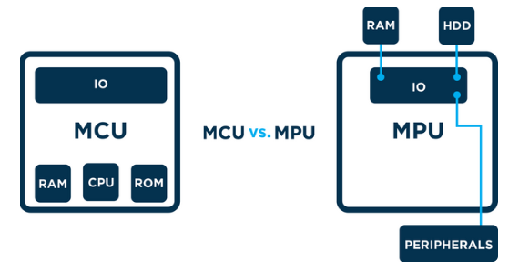
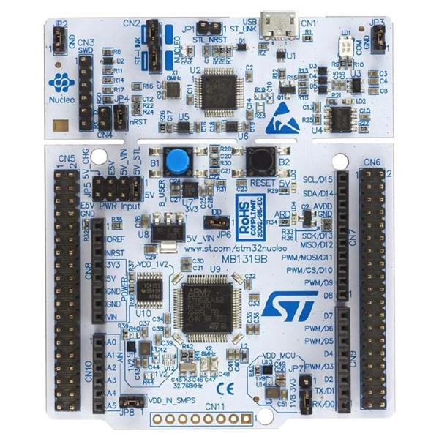

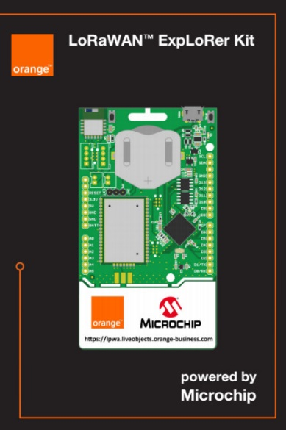
Micro-Controller Platform
Micro-Controller Unit (MCU) contains RAM, ROM and IO
Micro-Processor Unit (MPU) only contains the CPU
System on Chip (SoC) refers to MCUs with a greater number of onboard peripherals and functionality
http://www.ti.com
http://www.microchip.com

Slide 11
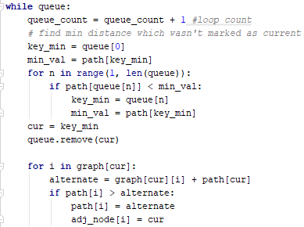
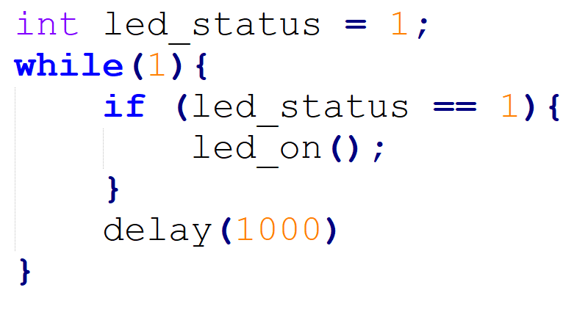
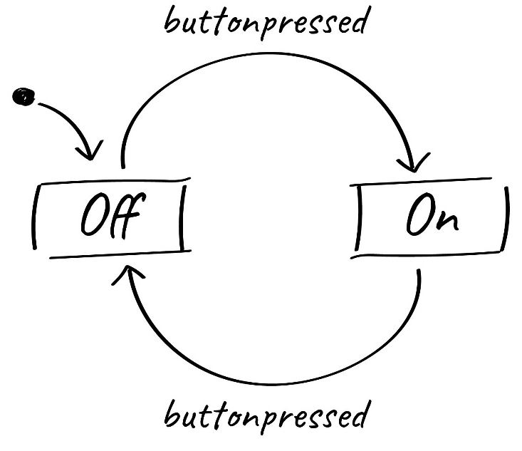
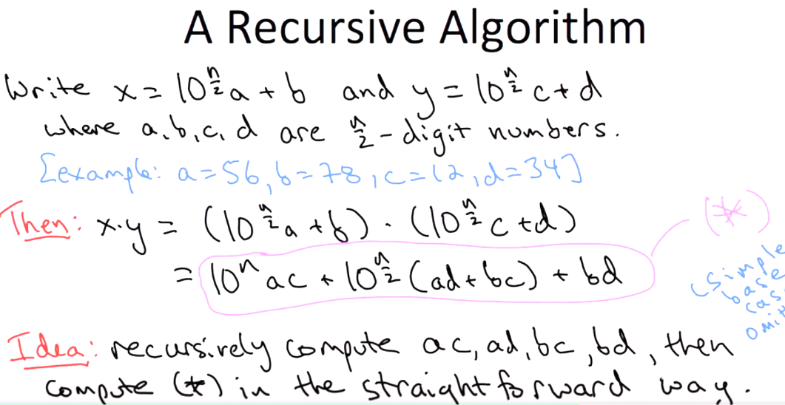
Program on MPU vs MCU

Slide 12
Warm up Exercises
LED turns on and off every second (LED Blinky)
LED turns on for 3 seconds and then turns off for 5 second.
Digital Clock with hour, minute and second
Change the delay from 1000 to 10

Slide 13

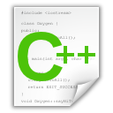
C Language: Header and C++ Files
#include “led.h”
int T_on;
int T_off;
int counter;
void setOn(long duration){
//TODO: set LED on here
}
void setoff(long duration){
//TODO: set LED off here
}
void delay(long duration){
//TODO: set delay here
}
#ifndef __LED_H_
#define __LED_H_
#include <system_lib.h>
#include “user_lib.h”
#include “UserFolder/lib.h”
extern int T_on;
extern int T_off;
void setOn(long duration);
void setoff(long duration);
#endif

Slide 14
C Language: Main File
#include “led.h”
#include “timer.h”
#include “gpio.h”
#include “button.h”
void main(){
initGPIO();
initTimer();
initButton();
initLED();
….
….
while(1){};
}
void timer_isr(){
}
void ext_isr(){
}
Modules/ Libraries are included
LED
Modules/ Libraries are initiated
TIMER
GPIO
System operations are implemented in interrupt functions
BUTTON

Slide 15
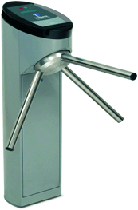
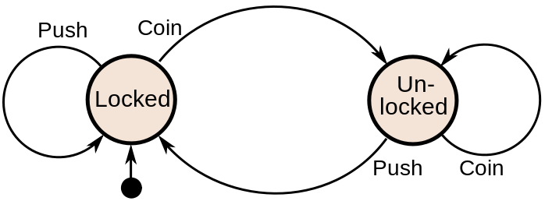
Finite State Machine (FSM)
Finite-State Machine (FSM) or Deterministic Finite Automata (DFA), finite automaton, or simply a state machine, is a mathematical model of computation
Current State | Input | Next State
Locked | Coin | Unlocked
 | Push | Locked
Unlocked | Coin | Unlocked
 | Push | Locked
A turnstile

Slide 16
Finite State Machine Programming
while(1){
  switch(status){
    case LOCKED:
    lock_turnstile(); //operation in a state
    if(Coin == true) //transition condition
    status = UNLOCKED; //next state
    break;
    case UNLOCKED:
    unlock_turnstile(); //operation in a state
    if(Push == true) //transition condition
    status = LOCKED; //next state
    break;
    default:
    break;
    }
}

Slide 17
Example
Given an LED turns on for T_on and then turns off for T_off.
  Design an DFA for this LED
  Implement the DFA in Arduino
digitalWrite(13, HIGH): turn on the LED
digitalWrite(13, LOW): turn off the LED
setTime(duration): set a clock (timer_flag = 0), when the clock is expired, timer_flag = 1; duration is in mili-seconds.

Slide 18
Answer
timer_flag == 1
INIT
LED_ON
LED_OFF
timer_flag == 1
INIT: Set pin 13 to OUTPUT mode, set timer
LED_ON: Turn on the LED
LED_OFF: Turn off the LED

Slide 19
Answer (Arduino Code)
void loop(){
  switch(status){
    case INIT:
    pinMode(13, OUTPUT);
    setTimer(T_on);
    status = LED_ON;
    digitalWrite(13, HIGH);
    break;
    case LED_ON:
    if(timer_flag == 1){
  status = LED_OFF;
  setTimer(T_off);
  digitalWrite(13, LOW);
    }
    break;
    case LED_OFF:
    if(timer_flag == 1){
  status = LED_ON;
  setTimer(T_on);
  digitalWrite(13, HIGH);
    }
    break;
    default:
    break;
    }
delay(10);
}
void timer_run(){
if(timer_counter > 0)
timer_counter--;
if(counter_timer == 0)
timer_flag =1;
}
void setTimer(long duration){
timer_counter = duration;
timer_flag = 0;
}

